Slide 1

User Overview
Pre-Interview
Meet Dmitry👋
Notes:
User ID: 195433837

Slide 2


User Profile
Admin Link
Name: | Dmitry Odessky | Tier:
Gender, Age: | Male, 43 | Recently used device/s: | AndroidTablet Samsung Galaxy Z Fold7 + Webapp Desktop
Country: | Switzerland | Industry: | Insurance
Nationality: | Swiss
Sign up date: | 29/03/2021
Product, Regulation: | CFD, Plus500SEY | FSA
Notes:
Mention country of birth if different from registered

Slide 3

Cashier Activity
First deposit date: | 10/06/2024
Last deposit date: | 16/01/2026
Total deposits: | 216,000.00 AED 58,807.51 $ | Bonuses (Last 6 months): 4 Ongoing deposit (Dec, 2025) - BtsConFulFilled
Deposit PM’s | CreditCard GooglePay | Rebates (Last 6 months): 4 (Dec 25-Jan26)- BtsConFulFilled
Total withdrawals: | 50,000.00 AED 13,612.85 $
Withdrawal PM’s | CreditCard Wire

Slide 4

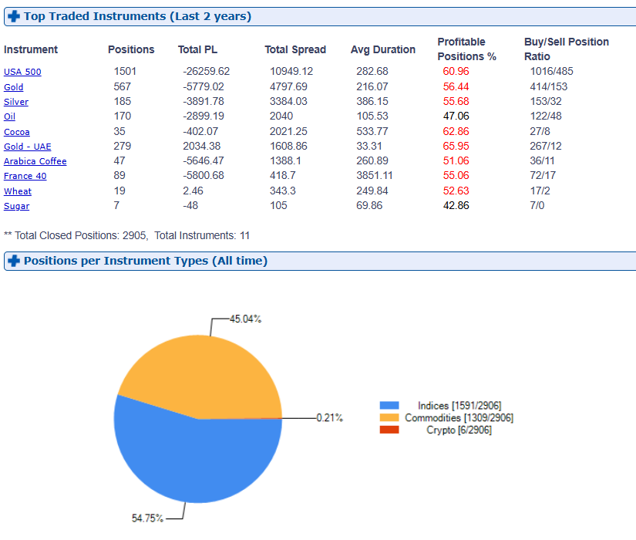
Trading Activity
Last real position date: 20/01/2026 on USA 500
Last demo position date: 10/11/2025
Trading Frequency: Many times a day
Total P\L: -157,942.90 AED/ -43,003.40 $ Current balance: 8,114.07 AED/ 2,209.11 $ Recent Margin Calls: 8,114.07 AED 2,209.11 $ Risk Management Usage Frequency: StopCall often
Notes:
Trading frequency: Many times a day / Once or twice a day / A few times a week / A few times a month / Infrequently
Risk management usage via heap dashboard or positions screen filter in admin
User’s top traded instruments & positions per type is available in admin under user’s CFD real account\Summary

Slide 5
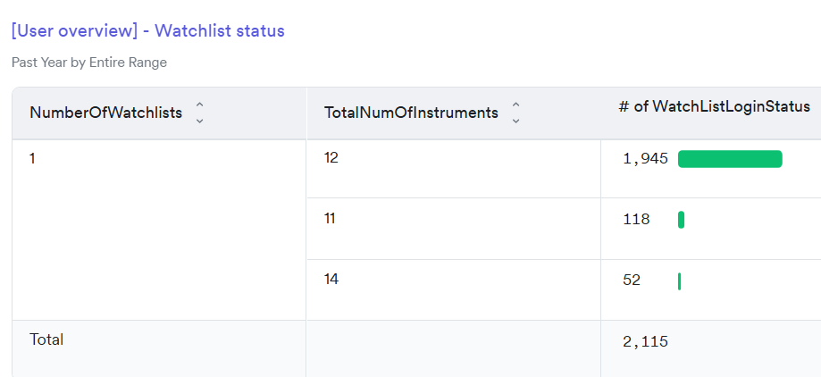
Features Usage (last year)
✧
Heap Link - User overview
Chart: | Yes Recent activity on Jan 2026 | Insights: | No
Alerts: | No | PlusMe: | No
Watchlists: | Yes | PlusAI: | No
Instruments search with no results: | No
Notes:
Heap features usage dashboard (Must update Identity equals user ID): https://heapanalytics.com/app/env/280771416/dashboard/Customer-Interview-User-overview-Dashboard-525349
Alerts - Admin CFD real account \ Instrument Alerts
✕ ✓

Slide 6

Support History
Did the customer contact customer support in the past year?
No
Tickets:
The user were requested to upload the documents - 10359555
The user accepted Premium invitation: Till Lindemann live in Dubai - 10365823

Slide 7
Any Additional Information
Customer has been upgraded to Premium tier from None tier. Trigger: Admin. Event Date: 2025-08-03 13:00:23
Account Manager:Razi Hanna

